Slide 1
Introduction to Clustering
Linden Lu

Slide 2
Introduction to Clustering
K-means
DB-SCAN
Case Study – Credit Card Data

Slide 3
Introduction to K-means Clustering
Linden Lu

Slide 4
Introduction to K-means Clustering
K-means
Choose k centers randomly
Form k groups by centers
Recalculate centers of k groups
Repeat 2–4 until no change in groups or reach max_iter
Calculate total distance D
Repeat 1–6 pre-defined times (n_init)
Choose groups with smallest D as final clusters

Slide 5
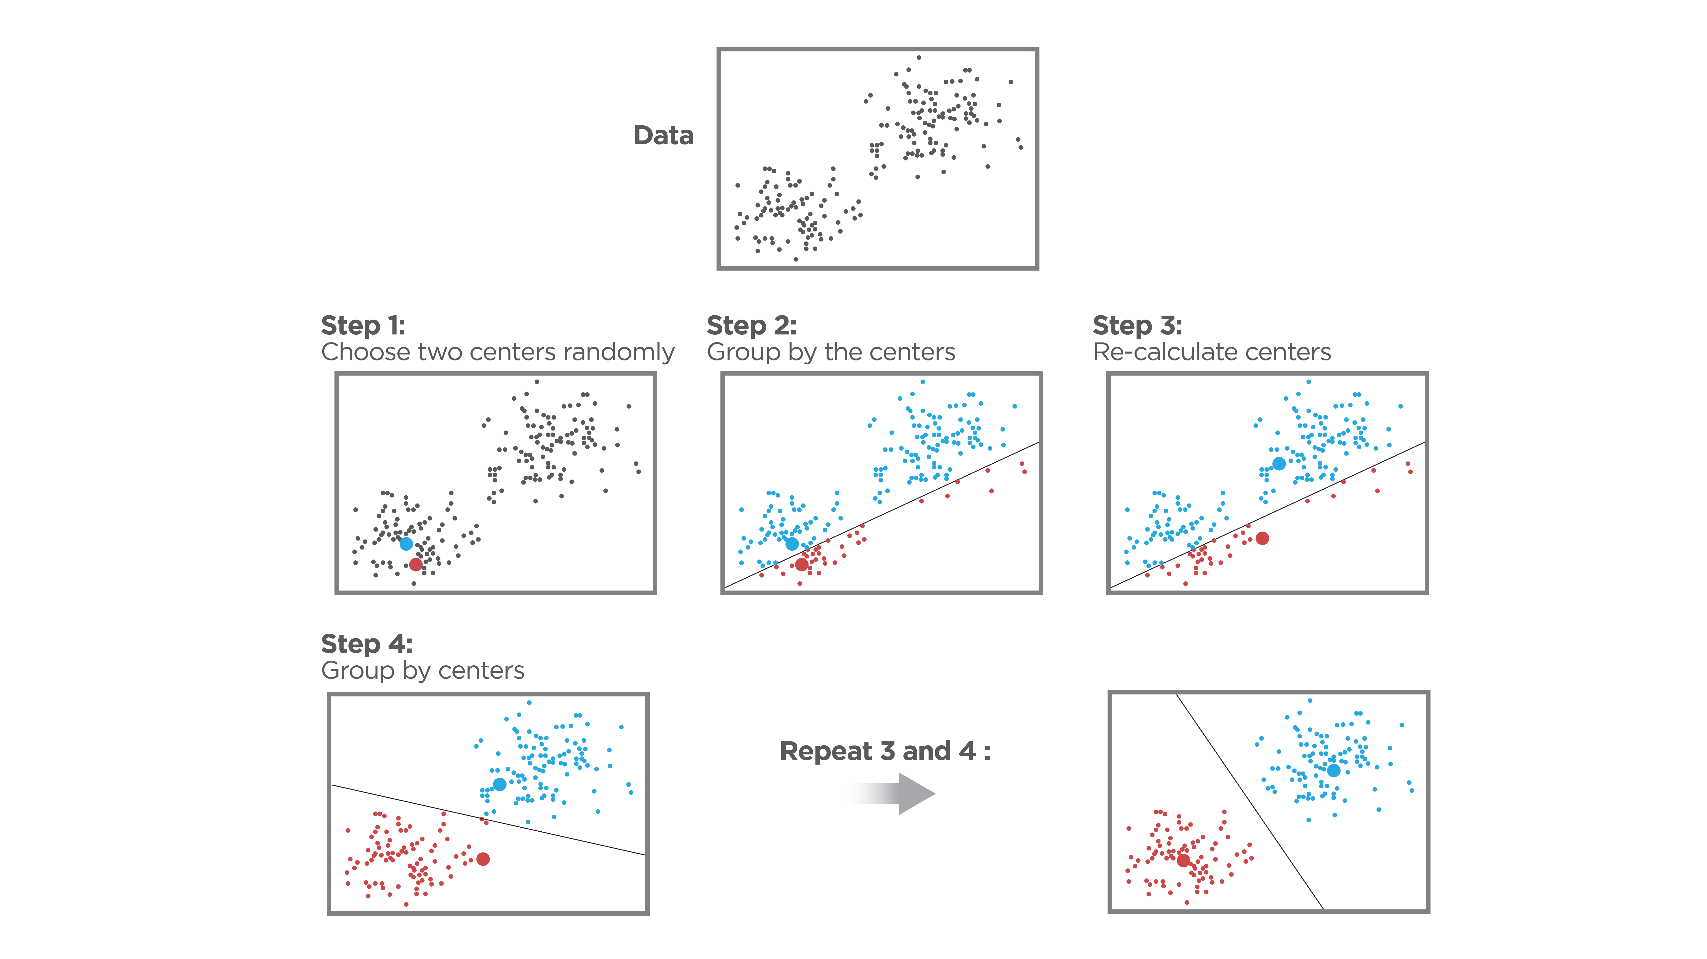
K-means (k=2)

Slide 6
Principal Component Analysis (PCA)
Reduces dimension
Retains major characteristics of original features
Helps visualize clusters

Slide 7
Scikit Learn K-means Model
Scale features
No train-test split
Hyperparameters
n_clusters: number of clusters, 𝑘
n_init: number of times to choose different initial centers, default 10
max_iter: maximum number of iterations for the algorithm in any given run, default 300
random_state: random seed, enables reproducibility

Slide 8
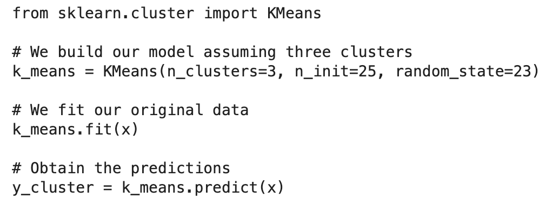
Scikit Learn K-means Model

Slide 9
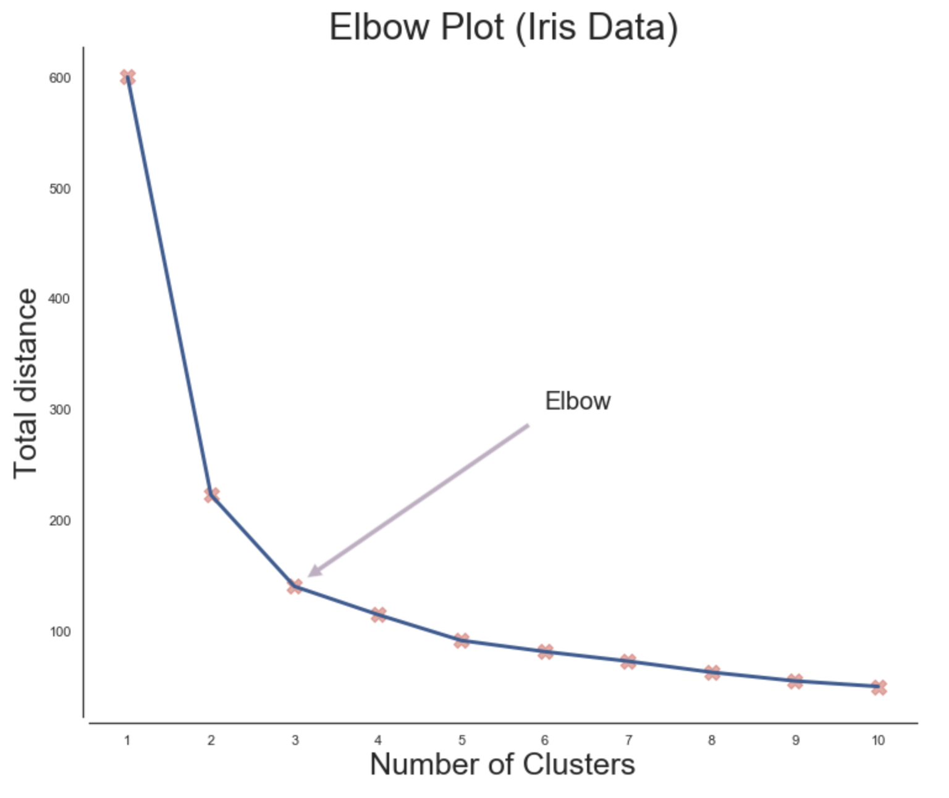
Determine K: Elbow Method

Slide 10
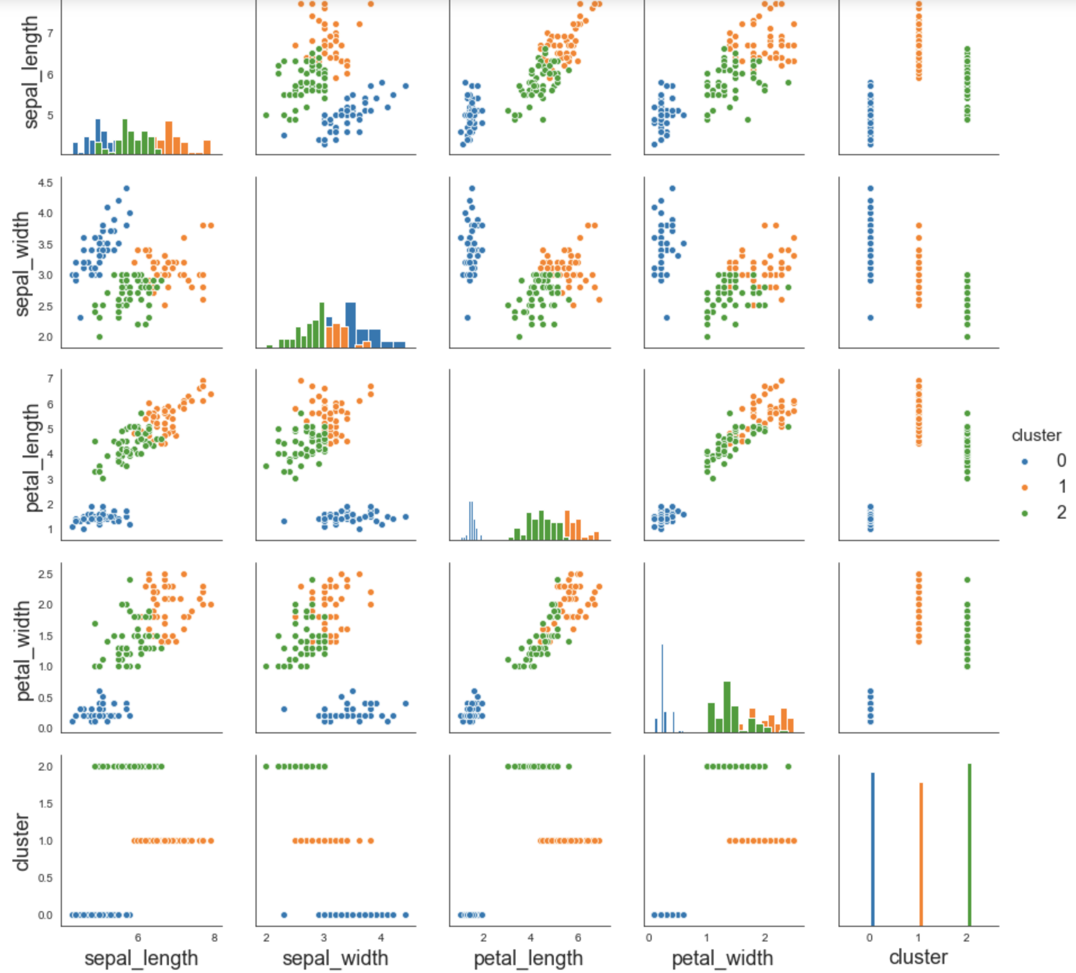
Explore Cluster Characteristics

Slide 11
Cluster Evaluation
Adjusted Rand Index
-1 to 1
Compare with true class
Silhouette
-1 to 1
Don't use true class
Compare distance to assigned center and next closest center

Slide 12
K-means Case Study
Linden Lu

Slide 13
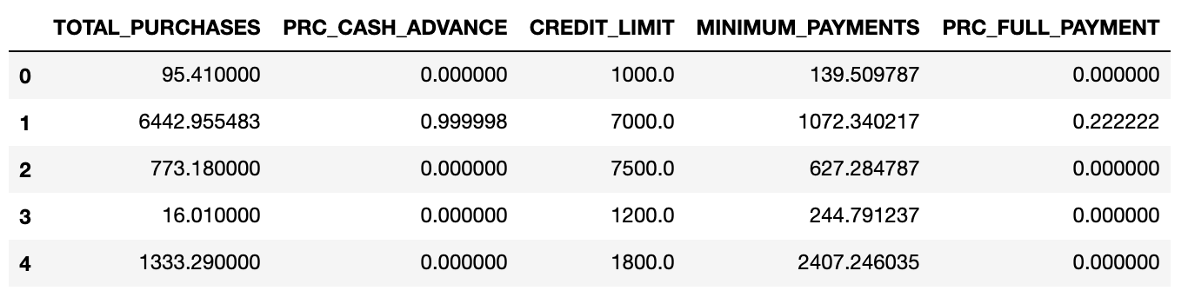
K-means Case Study
Credit Card Dataset

Slide 14
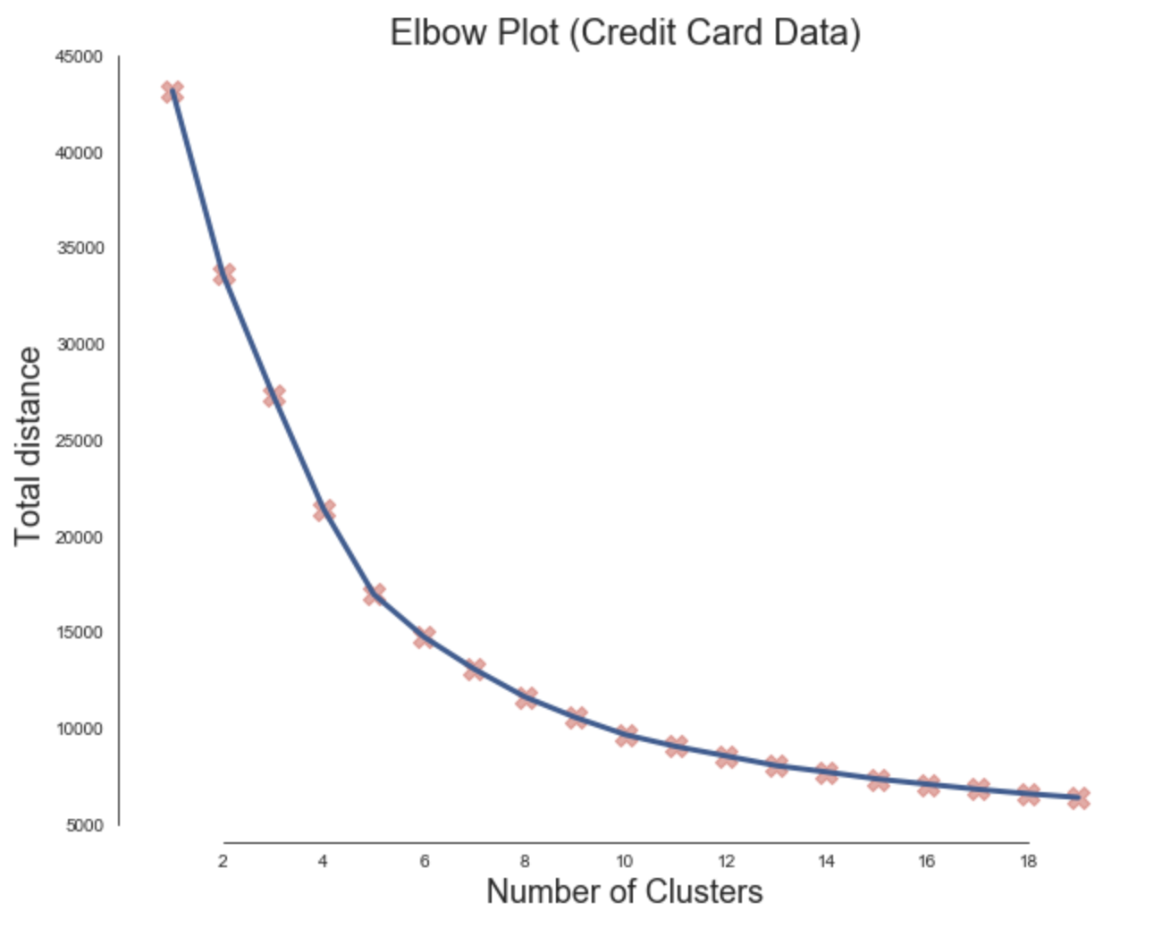
Determine K

Slide 15
Cluster Member Counts
Cluster 0 : 3436 members
Cluster 1 : 2572 members
Cluster 2 : 1270 members
Cluster 3 : 1233 members
Cluster 4 : 56 members
Cluster 5 : 69 members

Slide 16
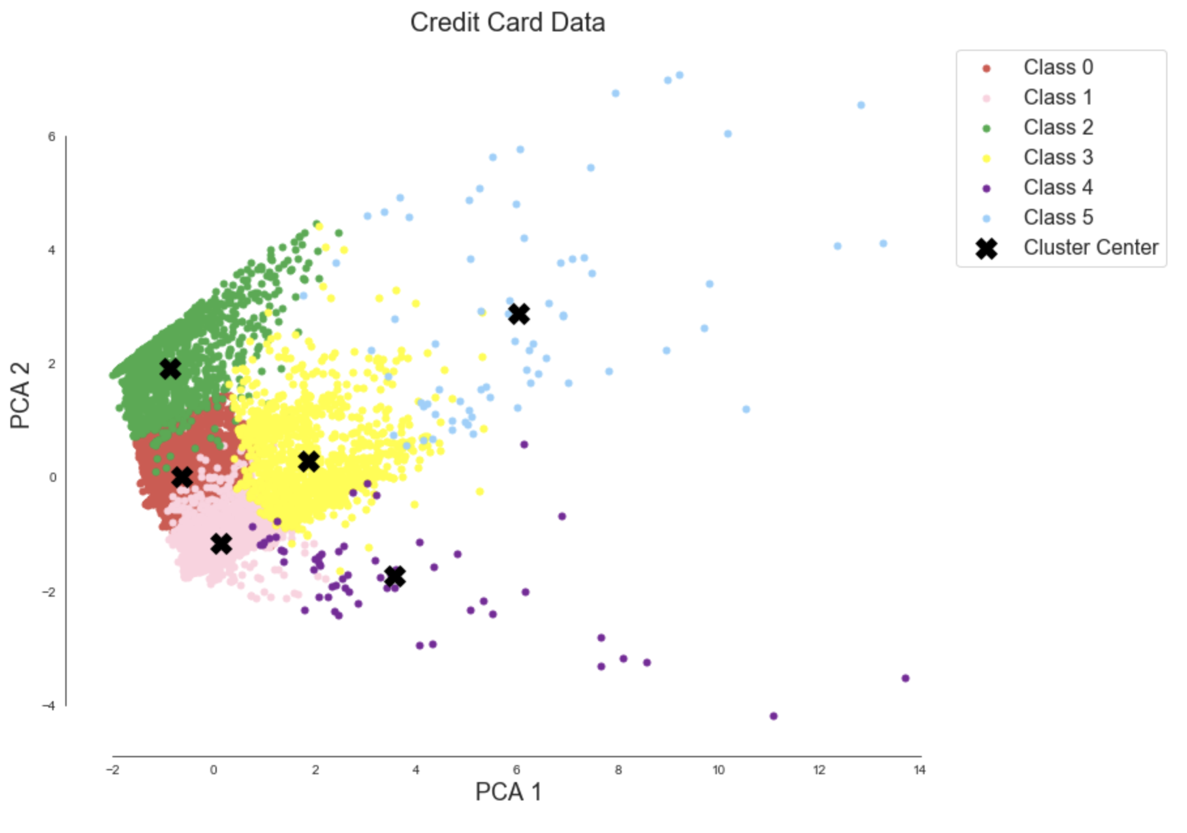
Visualize Data

Slide 17
Introduction to Density Based Clustering
Linden Lu

Slide 18
DBSCAN
Hyperparameters
eps: Max distance between two points to be considered as in same neighbor
min_samples: Number of points that must lie within the neighborhood of the current point in order for it to be considered a core point
Point Categories
Core point: At least min_samples of points within distance eps
Border point: A core point, but within eps to at least one core point
Noise point: Neither core point nor border point
Clusters
All core points that are reachable to each other form a cluster. All border points of these core points also belong to the cluster.

Slide 19
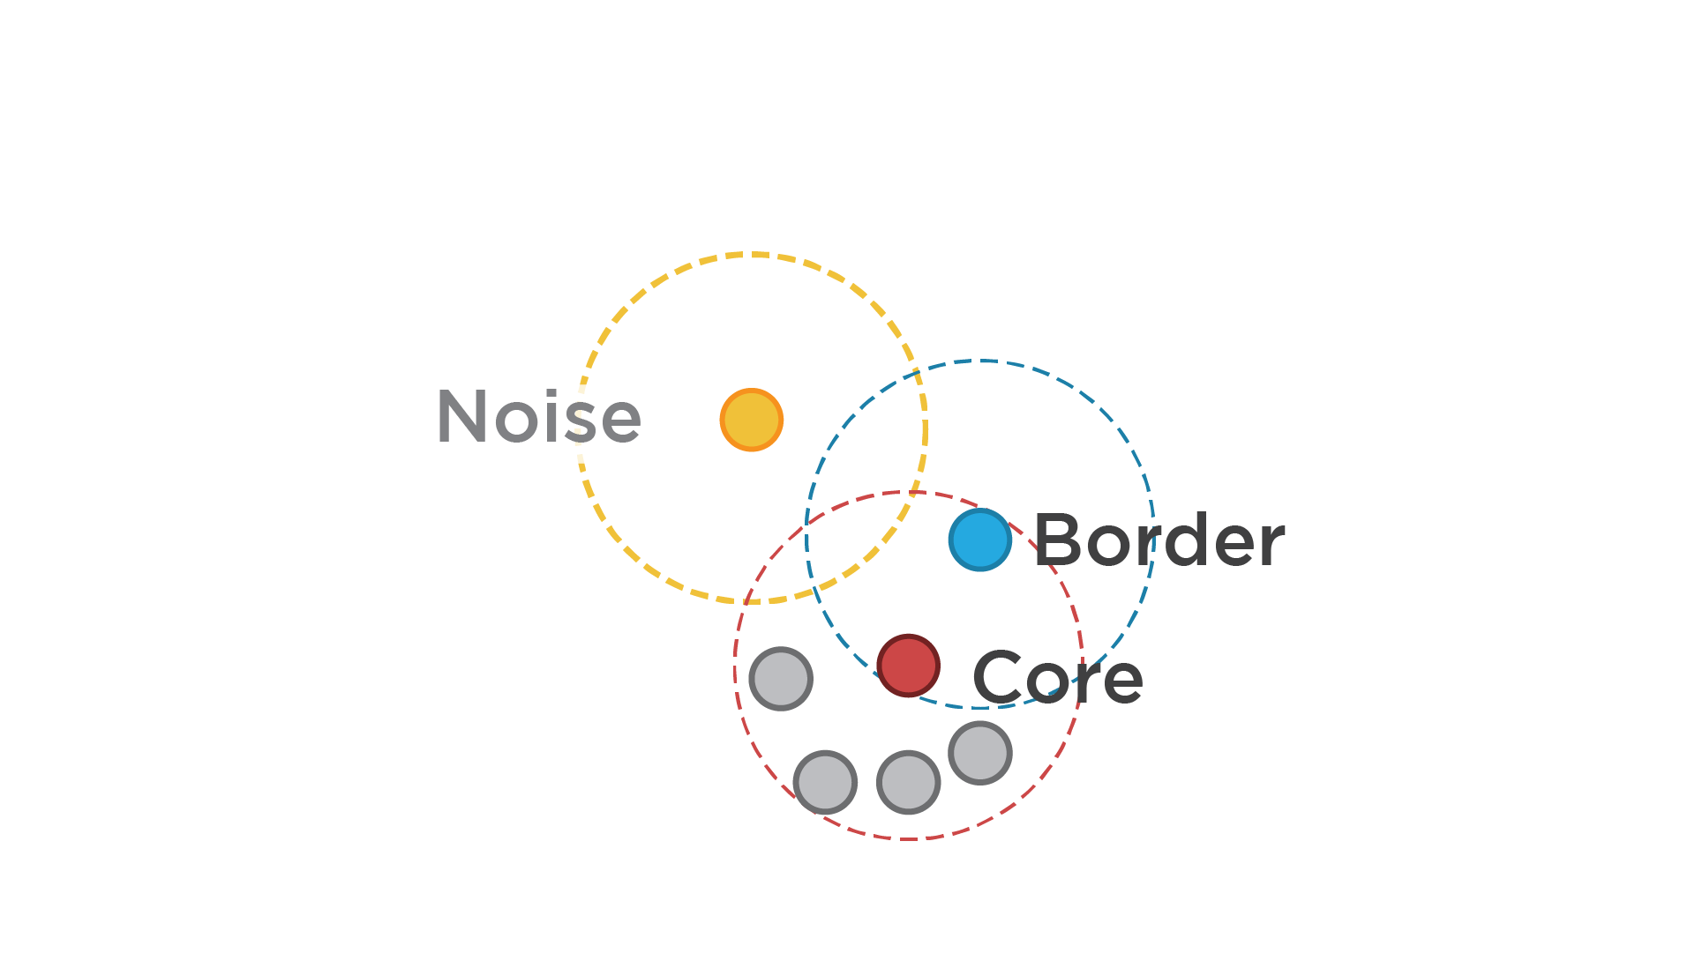
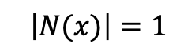
$$\left|N(x)\right|=1$$
minpts = 4

Slide 20
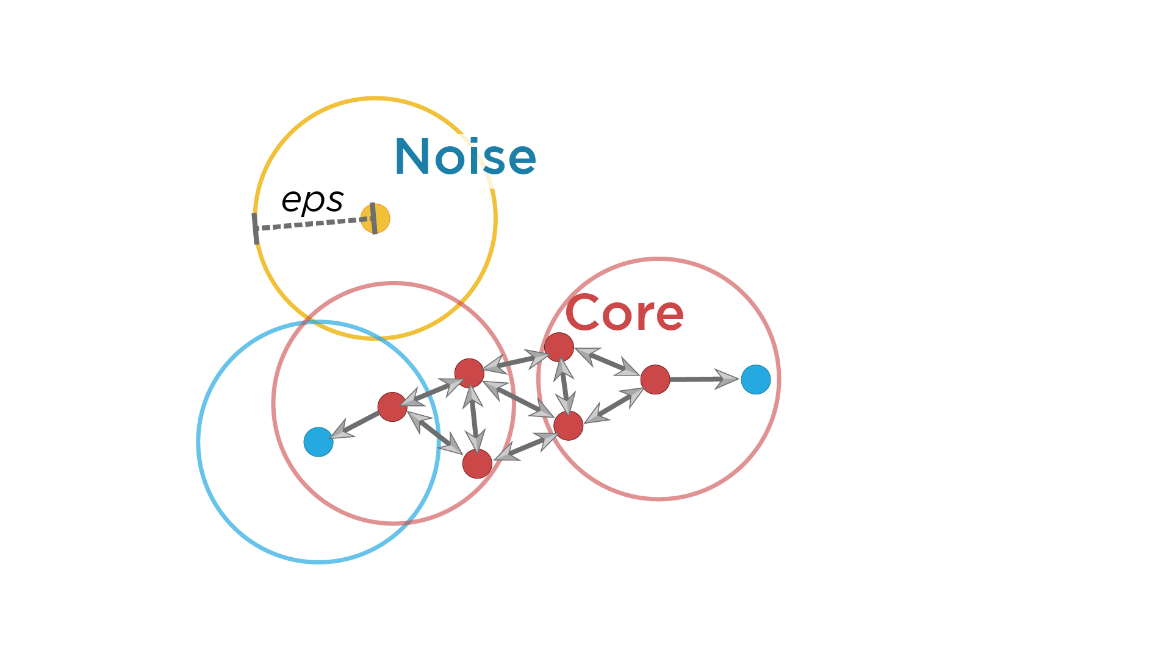
MinPts = 4
Red: Core Points
Yellow: Broder points. Still part of the cluster because it’s within epsilon of a core point, but does not meet the min_points criteria
Blue: Noise point. Not assigned to a cluster

Slide 21
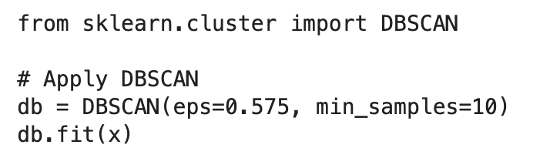
Scikit Learn DBSCAN Model

Slide 22
Hyperparameter Estimation
min_samples
Greater than number of features, i.e., 2 times
eps
Small eps preferable
k-distance graph

Slide 23
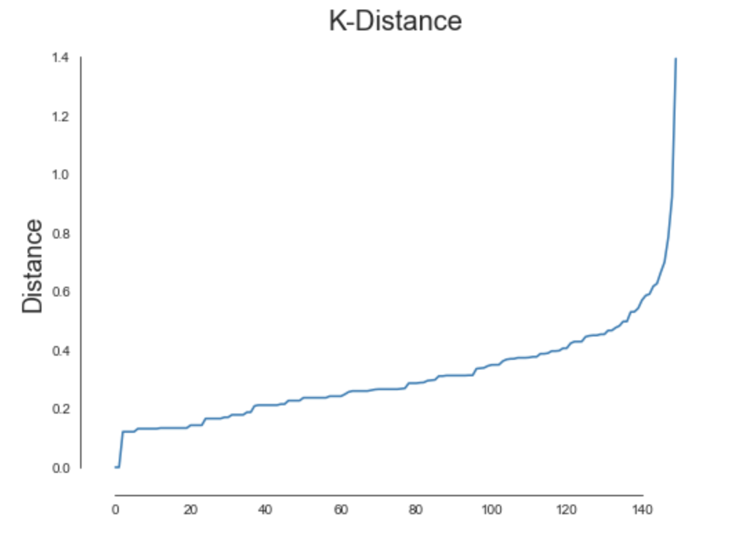
K-distance Graph
Plot distance to nearest neighbor for all data points.
Choose a distance at elbow that covers majority of data points.

Slide 24
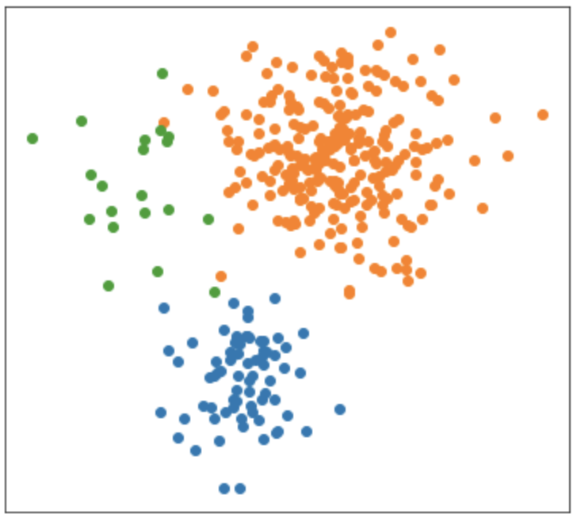
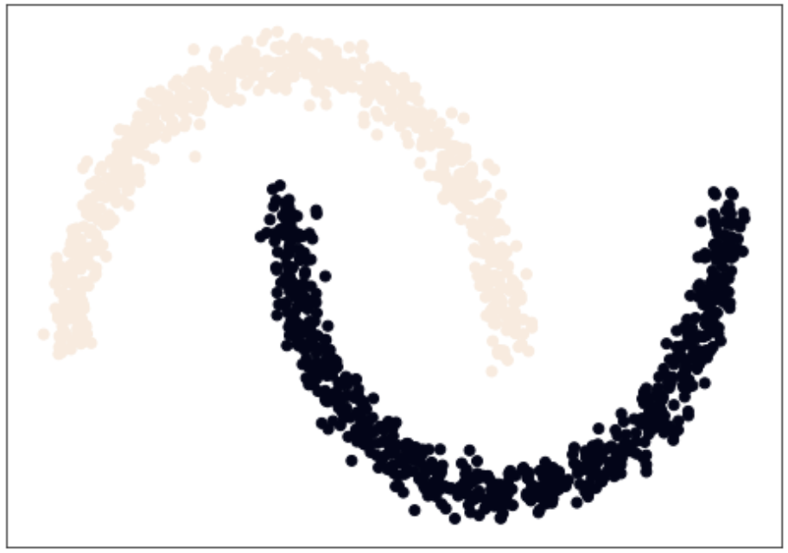
K-means vs. DBSCAN
K-means works well
K-means works poorly but DBSCAN works well

Slide 25
Credit Card Data Visualization

